Slide 1
Ratings Model Master
Overview & Details
30th November, 2016

Slide 2
Overview
The Ratings Model Master gives the user flexibility to add/delete/edit parameter groups, parameters and relevant categories to be applied to the Credit Score Card to arrive at the Credit Score and Rating.
Parameter Groups – Can be selected from the existing Parameter Groups or entered manually by the User.
Parameters – Can be selected using the relevant Source and Field. Source of a parameter can be selected from the following list of drop-down choices –
Profit & Loss Account
Balance Sheet
Ratio
Cash Flow Statement
Account Details
Banking Analysis
CIBIL
RTR
Categories –
If the selected Parameter has a drop-down menu associated with it, all the available drop-down choices for the Parameter are shown as Categories. These Categories are non editable, except for the label that is displayed on the screen.
If the selected Parameter is of a numeric type in the application, User can add categories by defining relevant ranges using the mathematical operators provided. Multiple categories can be added using the ‘Add Category’ button. For numeric type of Parameters, the user can select the time period and value type.
Time Period : There are three options for the User to select for Parameters selected from Balance Sheet, Profit & Loss, Ratio & Cash Flow Statement –
Last Audited Year Available : This selection enables user to match the relevant value from the Last Audited year with the ranges being defined as categories.
Provisional Preferred : This selection enables user to match the relevant value in the order Latest Available Provisional > Last Audited year with the ranges being defined as categories.
Estimated Preferred : This selection enables user to match the relevant value in the order Estimated > order Latest Available Provisional > Last Audited year with the ranges being defined as categories.
For the other type of Parameters, the Time Period is ‘Not Applicable’.
Value type : For numeric type of Parameters there can be two value types – Default (number) and Percentage. If the selected field as a Parameter is a percentage, user must select Percentage for Value Type, otherwise select Default.
User can also delete categories added is required.
The Parameter Groups can have multiple Parameters and the Parameters can have multiple Categories. They are arranged in expandable sections with Parameter Groups as parent node, Parameters as children nodes and categories as grand children nodes for each Parameter.
The scores for Categories and weights for Parameters and Parameter Groups can also be defined using the Ratings Model Master.

Slide 3
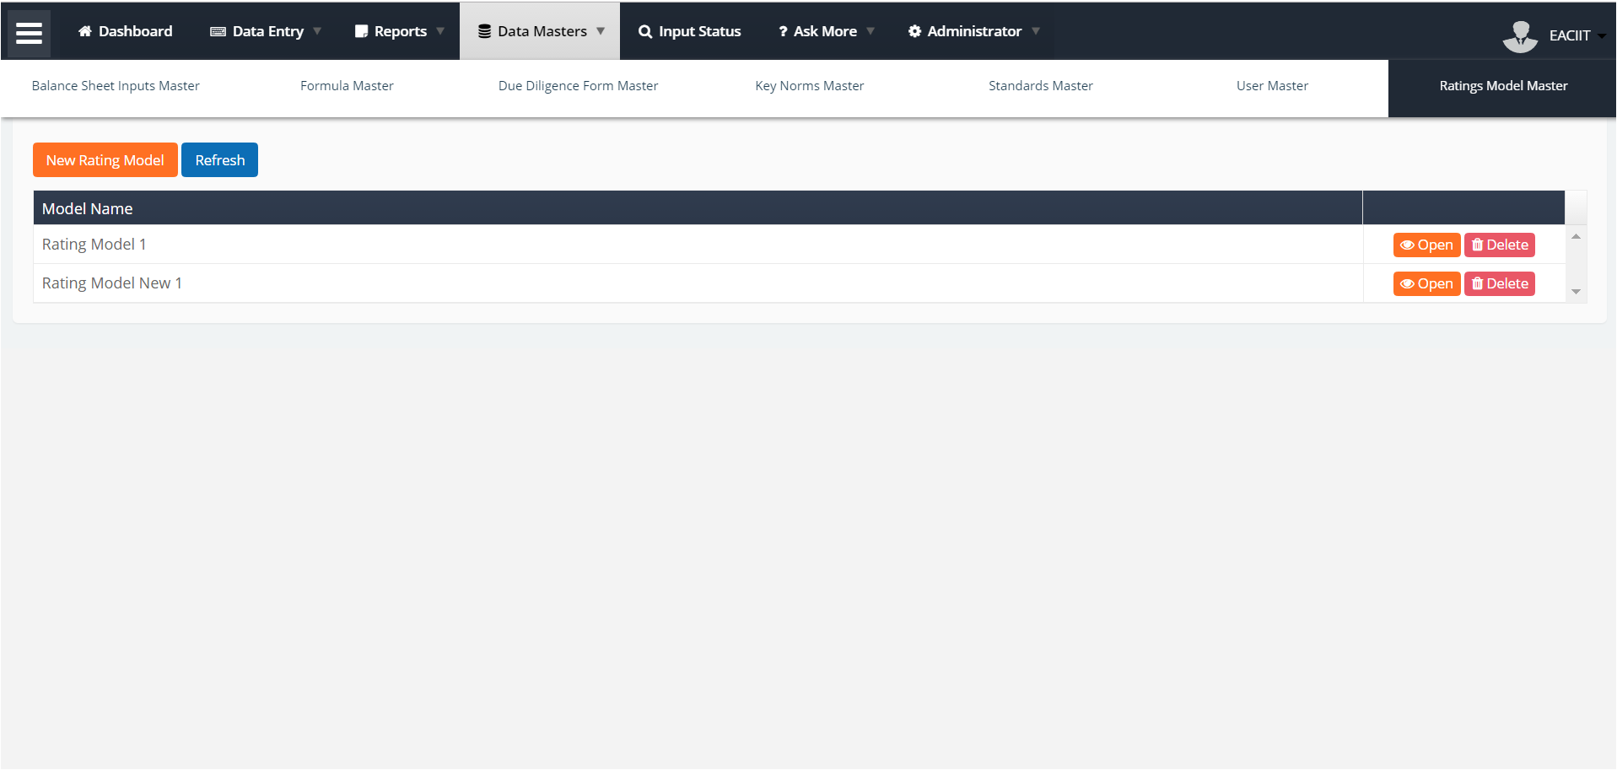
Creates new Rating Model by duplicating the Base Rating Model. The details screen of the Rating Model is opened where User can rename the Rating Model and make desired changes.
* As per current implementation, the new Rating Models cannot be applied to the Credit Score Card, only the Base Rating Model can.
Base Rating Model applied to the Credit Score Card in the current implementation.
Open / Delete the Rating Model

Slide 4
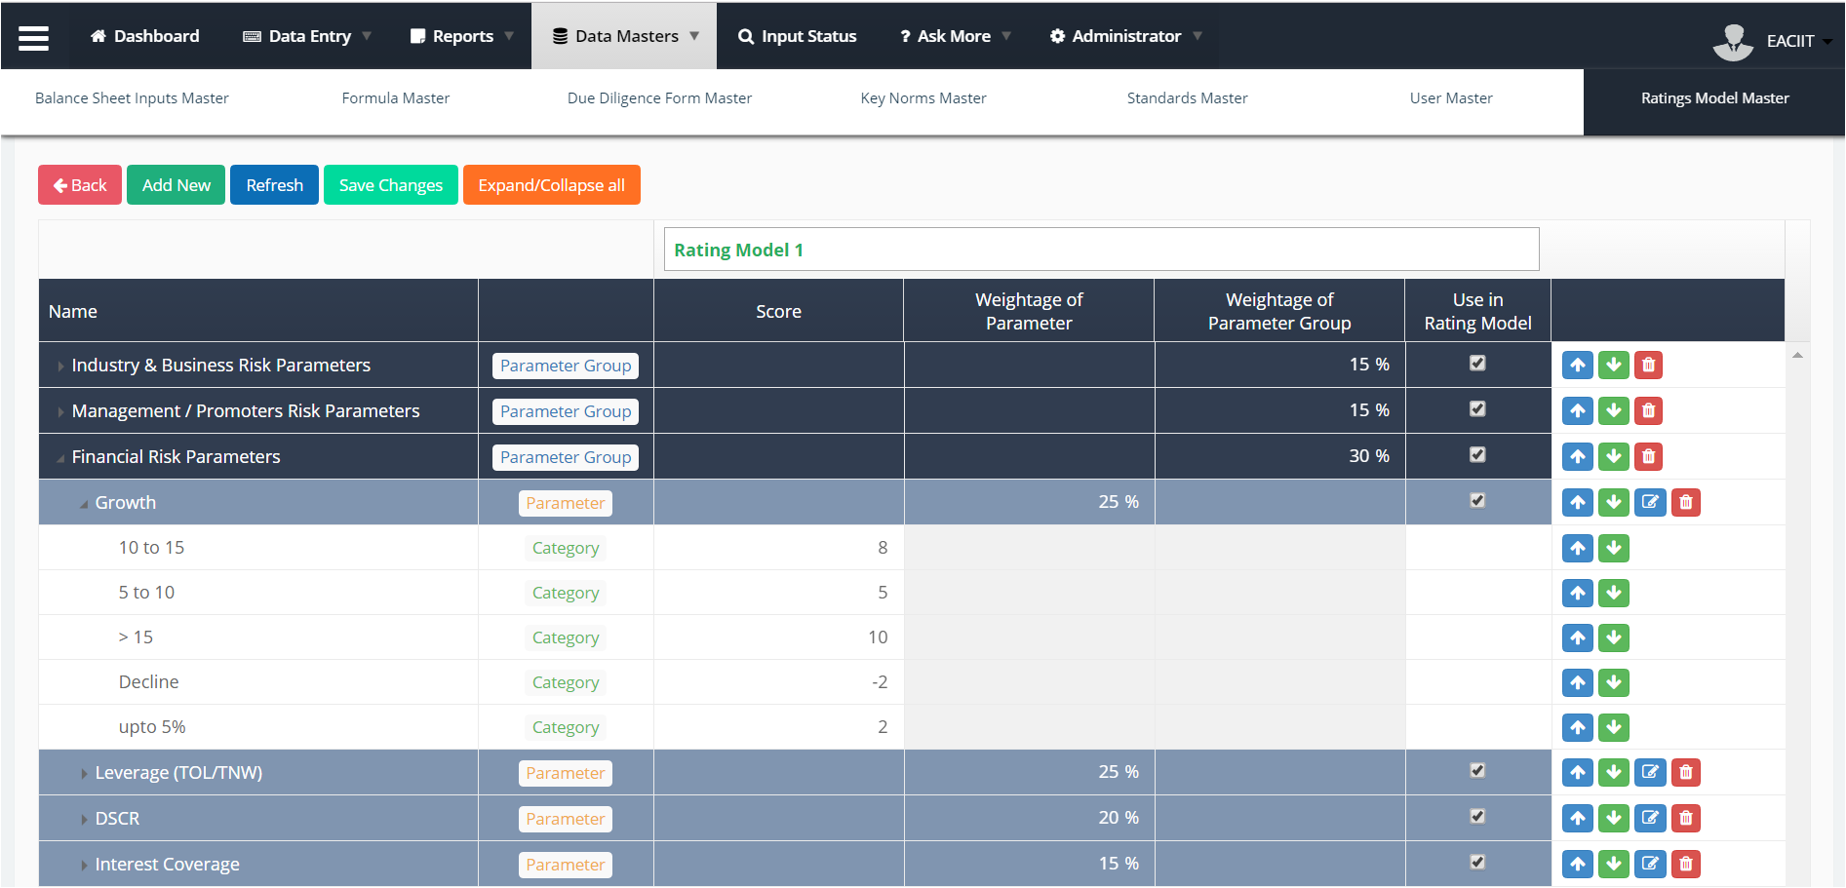
Add new – Parameter Group / Parameter. Described on the next page.
Rename the Rating Model Master.
Controls visibility of a Parameter / Parameter Group / Category in the Credit Score Card
Go Back to the previous (landing) screen of Ratings Model Master
Up / Down buttons to change the positioning of the Parameters in the layout. Edit button (blue) to update the Parameter & Categories.
Save Changes made in the scores, weights and order of Categories and Parameters.
Expands/Collapses all sections on the Ratings Model Master.
Update the weights of Parameter Groups, Parameters and Scores.

Slide 5
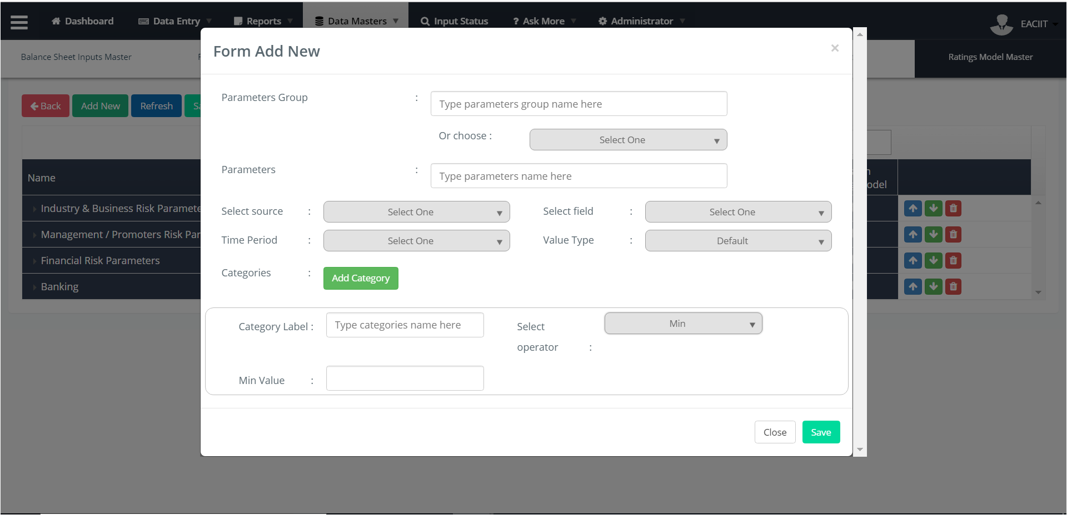
User can –
Select a Parameter by choosing the relevant Source and Field.
Rename the Parameter from this box if needed; this field will show the selected Parameter pre-populated.
User can –
Select from a list of Parameter Groups.
Type a Parameter Group name, in case he wants to create a new Parameter Group.
This is a mandatory field.
User must select the time period of the Parameter selected. This is applicable only when User has Source selected as Balance Sheet, Profit & Loss, Ratio and Cash Flow Statement.
Default value for this drop down is Last Audited.
It is not a mandatory field
User must select the field to be used as a Parameter in Ratings Model.
It is a mandatory field.
User must select the type of the Parameter selected.
It can be Default (number) or Percentage.
It is a mandatory field
User selects the source to select the Parameter to include it in the Ratings Model.
Dropdown comprises of Profit & Loss, Balance Sheet, Ratio, Cash Flow Statement, Account Details, Banking Analysis, CIBIL and RTR.
This is a mandatory field.
User can add relevant categories for the Parameter selected.
User can add a label for the category that needs to be display on the Rating Model.
User can select the operator like Min., Max., Greater than and equal to, etc. to define the category.
User can add relevant value to define the category.

Slide 6
Data Output
The Ratings Model Master creates a skeleton for the Credit Scoring Model. In current implementation, the Rating sheet of the Excel Scoring Models has been used to create the Base Rating Model, which applies to Credit Score Cards for all customers.
Add New button – On saving new Parameter Group / Parameter added it reflects in the Credit Score Card.
Edit button – On editing a Parameter / Category and saving the changes from the pop-up, the changes are reflected in the Credit Score Card.
Editing Scores or Percentages or changing the position of Parameter Groups / Parameters / Categories – Save Changes button must be clicked so that the changes made are reflected in the Credit Score Card.
Notes
Exceptions in Banking Risk Parameters as per Rating Sheet In Excel Scoring Model –
EMI Track – It has two conditions : Total Obligations POS and Max of DPD Track.
OD/CC Utilization (Average of 3 months) ABB vs. Proposed EMI – It has two conditions for OD/CC and Current Accounts.
The above two Parameters are created in the back-end and not using the Ratings Model Master. Although the Categories have been created appropriately using the Ratings Model Master.

Slide 7
<End of Ratings Model Master Specs>

